Slide 1

Windows CE Programming
1. Introduction to Windows CE
School of software Engineering
2005

Slide 2
Agenda
Hello Windows CE!
Windows CE features
  Compare with desktop version
  Compare with other embedded OS

Slide 3
Demo :
Hello Windows CE!

Slide 4
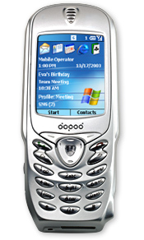
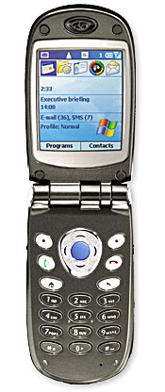
What can CE do: Mobile Phone

Slide 5
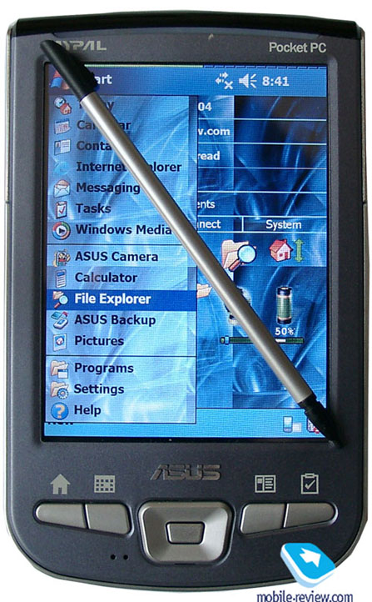
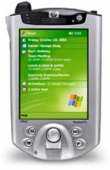
What can CE do: PDA

Slide 6
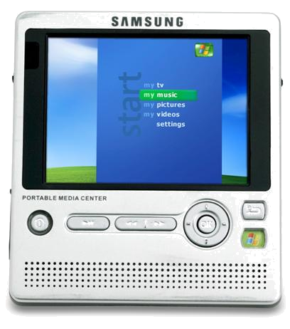
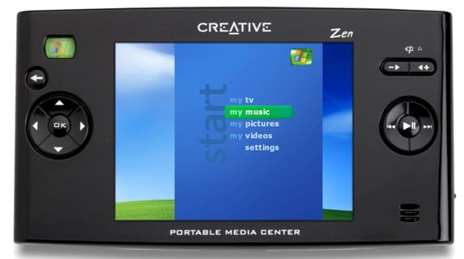
Portable Media Center

Slide 7
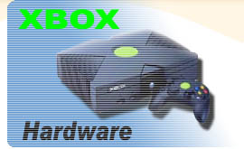


What can CE do:
Entertainment devices
Windows
Linux

Slide 8

What can CE do:
Car automotive
BMW
Citroën
Clarion Co. Ltd.
DaimlerChrysler
Fiat
Subaru
Honda
Hyundai
Mitsubishi
Toyota…

Slide 9
What can CE do : Other
Gateways
Industrial Automation
Set-Top Boxes
Medical Devices and Systems
ATMs
Projectors and Large Screen Displays
VoIP Devices
…

Slide 10
Windows CE history
First edition released in 1996
Windows CE .NET 4.x is widely used
The latest version Windows CE 5.0

Slide 11
Windows CE features

Slide 12
Compare with Desktop Version:
Hardware platform
Desktop Windows
Only runs on x86 architecture
Windows CE
ARM / Xscale
MIPS
PowerPC
SH
x86

Slide 13
Windows CE feature list
Windows CE can run on different hardware platforms.
How can we do that?

Slide 14
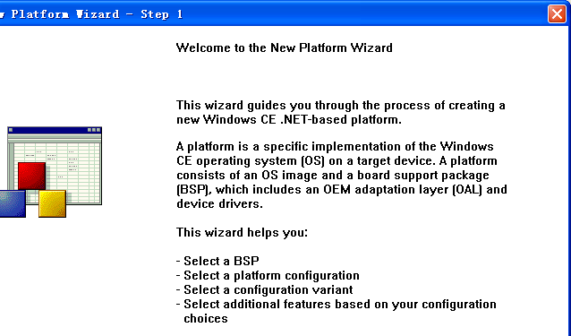
New Platform Wizard
The answer is BSP !

Slide 15
Introduction to BSP
Board Support Package is the software that implements and supports the OEM adaptation layer (OAL) and device drivers for a standard development board (SDB).
Operation System
Board Support Package
Hardware

Slide 16
Compare with Desktop Version:
Image Size
Desktop Windows
Windows 3.x : 2-5MB
Windows 98 : 400MB
Windows XP : 1.5GB
Lager and lager…
Can NOT be customized
Windows CE
Minimal : 200KB
Networking about 800KB
GWES, Shell and Apps about 4MB
Internet Explorer about 3MB

Slide 17
Windows CE feature list
Componentization
More than 200 optional components
Quick and easy to customize OS for a particular system

Slide 18
Compare with Desktop Version:
Real Time
Desktop Windows
No inherent real time support
Windows CE
256 levels of thread priority
Nested interrupts
Per-thread quantums
Priority inversion

Slide 19
Windows CE feature list:
Windows CE provide Real-time support
Real-time support is essential when dealing with time-critical applications.

Slide 20
Compare with Desktop Version:
Power management
Desktop Windows
No power management
Windows CE
Battery power / AC power
Devices can have their own power state
Turn off unnecessary device

Slide 21
Windows CE feature list:
Windows CE provides a Power Manager to manage device power and improve overall OS power efficiency
Windows CE can reduce the power consumption of a target device and to maintain and preserve the file system in RAM during the reset, on, idle, and suspend power states.

Slide 22
Compare with Desktop Version:
Programming Interface
Desktop Windows
ASCII / UNICODE
Rich API set
Powerful hardware platform
Windows CE
UNICODE only
Compact Version of Win32 API, MFC..
Processor, RAM, File System limitation

Slide 23
Windows CE feature list:
Windows CE only support UNICODE
  CHAR -> TCHAR / WCHAR
  strlen -> wcslen
Some APIs provide limited function
Windows CE only have limited resource

Slide 24
Compare with Desktop Version:
Micro Kernel
Desktop Windows
NT series is claimed to be micro kernel.
9x series is not micro kernel.
Windows CE
Complete micro kernel
  File system and device drivers run on user mode
  Kernel is responsible for passing message

Slide 25
Windows CE feature list:
Complete micro kernel
Enhanced reliability
Enhanced scalability

Slide 26
Compare with Desktop Version:
Share source code
Desktop Windows
Commercial software, source code is MS 1st level secret.
Windows CE
70% of Windows CE 5.0 source code is shared.
User can modify it.

Slide 27
Windows CE feature list:
Source code is shared
User can find shared source code under “%_WINCEROOT%\private” folder

Slide 28
Compare with other Embedded OS: Multimedia support
Other EOS:
Little build-in support for audio & video
No commercial web browser.
Windows CE
Rich UI element
Windows Media Player 9, support mp3, wav, avi, wmv…
Internet Explorer 6 & Pocket IE

Slide 29
Windows CE feature list:
Rich User Interface Element
Strong Multimedia support
Interact with desktop windows
  Pocket Word, Excel, PowerPoint, adobe reader
  Pocket MSN messenger
  Pocket IE, Windows Media Player
  SQL Server CE edition
  ACD See
  … …

Slide 30
Compare with other Embedded OS: Programming Interface
Other EOS:
Different programming interface
Typically use C/C++ & j2me
Windows CE
Win32 API
MFC, ATL, STL…
COM, ActiveX
.NET Compact Framework
Java VM
EVB, EVC…

Slide 31
Windows CE feature list:
Easy to get start for Windows programmer
Support multiple programming languages

Slide 32
Compare with other Embedded OS: image size and real time
Other EOS:
RTLinux, µC/OS-II support hard real time
Vxworks min size : 8k
µC/OS-II min size : 2k
Windows CE
No hard real time support
Image size is too large for specific usage

Slide 33
Windows CE advantages:
Rich optional components and functions.
Can be strongly customized.
Easy to use.
Same programming interface with desktop windows.
Rich MS and third party applications.

Slide 34
Windows CE disadvantages:
Image size is still too large for specific use.
No hard real time support.
Not free :
  3$ per runtime license
  995$ for Platform Builder
Performance & Security ??

Slide 35
Homework
Build your own Windows CE platform with Platform Builder and run it.
Be familiar with Windows CE GUI, File System structure, Control Panel…
Write a tic-tac-toe application with Platform Builder and play it on your own Windows CE platform.

